Slide 1
Statistical hypothesis test

Slide 2
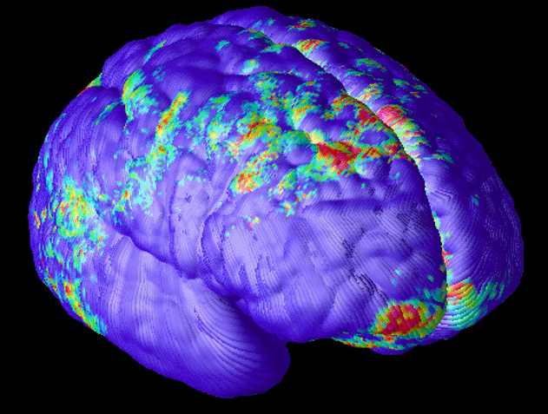
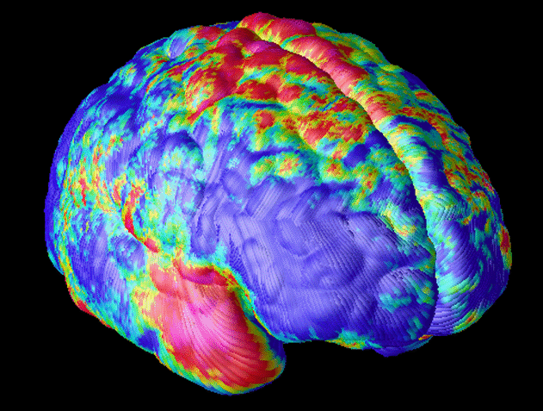
Statistical hypothesis test
Null hypothesis
H₀: x = y, H₀: x - y = 0
X
Normal controls
Y
Patient group

Slide 3
Statistical assumptions
Statistical independence
- univariate or
- multivariate
Null distribution
- parametric or
- nonparametric

Slide 4
Univariate parametric test
Null distribution
Test statistic
Normal distribution
Student’s t distribution
F distribution
sample mean m, sample variance SE
degree of freedom ν
degree of freedom p and n-p-k

Slide 5

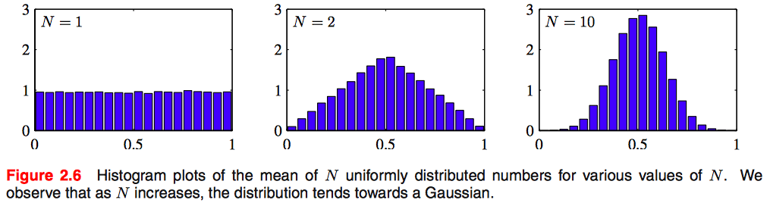
Normal distribution (From Bishop’s machine learning book)
The distribution that maximizes the entropy is the Gaussian.
The central limit theorem (due to Laplace) tells us that, subject to certain mild conditions, the sum of a set of random variables, which is of course itself a random variable, has a distribution that becomes increasingly Gaussian as the number of terms in the sum increases (Walker, 1969).

Slide 6
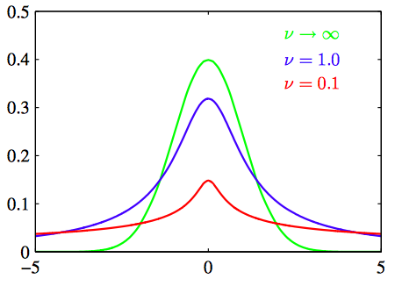
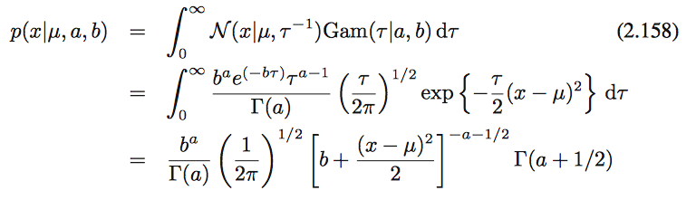

Student’s t distribution (From Bishop’s machine learning book)
mean
precision
shape
scale⁻¹
ν = 2a : degree of freedom, λ=a/b (precision)
Student’s t-distribution is obtained by adding up an infinite number of Gaussian distributions having the same mean but different precisions. This can be interpreted as an infinite mixture of Gaussians.

Slide 7
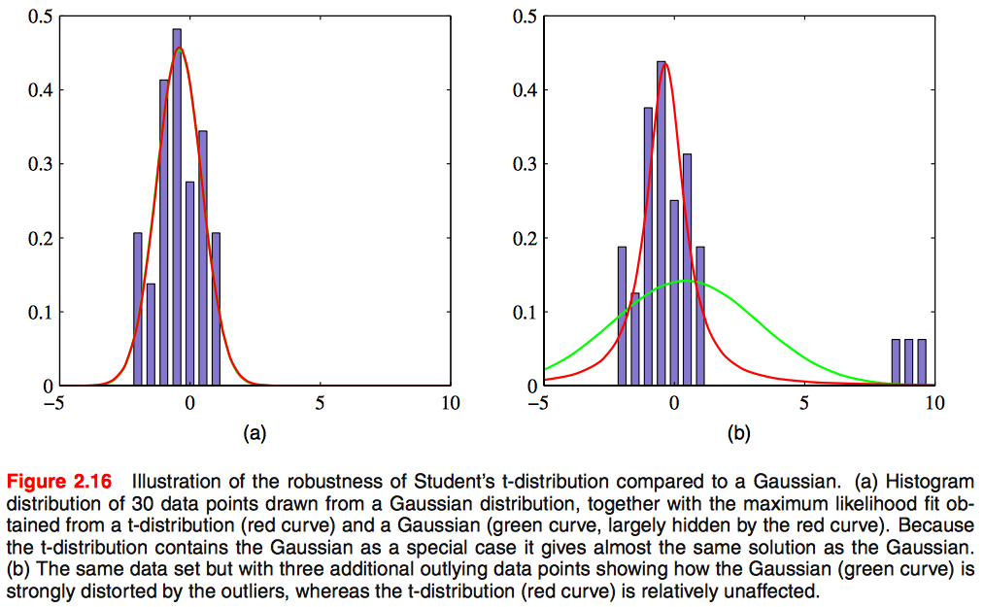
Student’s t distribution (From Bishop’s machine learning book)
Student’s t distribution in general has longer ‘tails’ than a Gaussian. This gives the t- distribution an important property called robustness, which means that it is much less sensitive than the Gaussian to the presence of a few data points which are outliers.

Slide 8
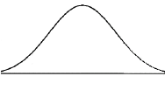

Decision
H₀: x - y = 0
p value
Type I error, false positive error α^{B}
: incorrect rejection of a true null hypothesis
significance level
0.001
0.005
0.01
0.05
0
x'-y'
p = P(x-y > h) < α^{B} → Reject H₀
> α^{B} → Accept H₀

Slide 9
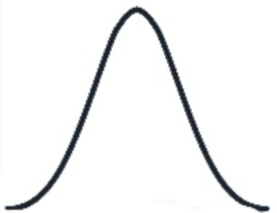

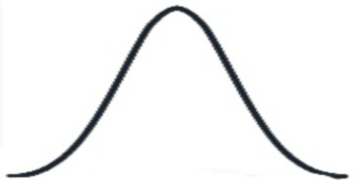
Z test
H₀
Z =
X - m
~ Z_{0,1}
SE
Z ~ standard normal distribution
with mean 0 and variance 1
- m : sample mean
- SE : sample variance/
0
z
X
Z
p
Normal
mean image
Patient
mean image
The voxel intensities are normally, independent, identically distributed.
-
=
p voxels
0
z_{i}
Estimate m and SE.
Which voxel satisfies
p < 0.005 ?
-

Slide 10

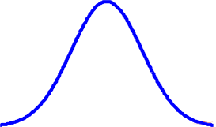
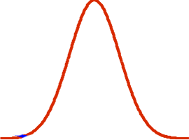
Student’s t test
H₀
t ~ student’s t dist. with
degree of freedom ν
0
t
Normal
n₁
Patient
n₂
t
p
Student’s t distribution
with ν_{i} for voxel i
for all voxels
0
t_{i}
voxel i
-
Which voxel satisfies
p < 0.005 ?
-

Slide 11
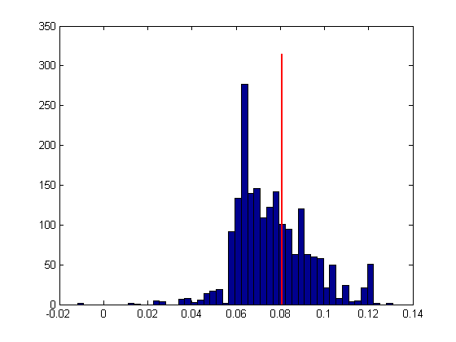
Nonparametric test
Example : FDG uptake of the ith voxel
H₀: x - y = 0
Permutation method
G1 (n1)
G1 (n1)
1
x
G2 (n2)
x-y
G2 (n2)
y
Histogram
H₀
Random data set 1
Original data set
Population data set
x-y
5000
G1 (n1)
x
G2 (n2)
x-y
y
Random data set 5000

